Slide 1
Data Science in Geology Projects
Olawale Ibrahim

Slide 2
A Quick Distinction
Data Science
Data Analytics
Simulates human intelligence
Might not be dependent on data
Uses different types of systems, expert, intelligent systems
Examples chatbots, IoT applications, robotics
Subset of AI
Heavily dependent on data
Involves prediction, training algorithms
Email spam filters, recommendation systems, predictive applications
Artificial Intelligence
Involves different techniques like statistics, machine learning, data mining for studying and understanding data
Involves using predictive model to solve identified problems
It involves data analysis
Mainly involves analysis of data to identify trends, patterns, for decision making
Does not involve the use of predictive model
It is a tool in data science
Machine Learning

Slide 3
Need for Data Science in Geoscience Projects
More data, more insights, better interpretation
Solve time demanding and repetitive tasks
Cost efficiency
First, second order interpretation
Quality check
A caveat to bear in mind: Data Science or Machine Learning is not posed as a replacement for the geoscientist, but in the hands of the right geoscientist, a powerful tool to make great improvements

Slide 4
The Peculiarity of Data Science in Geoscience Projects
Nature of the data and project
File formats
Structure
Data Size
Data Protection
Nature of tools available
Licensing
Information Security
Integration with existing workflows and tools

Slide 5
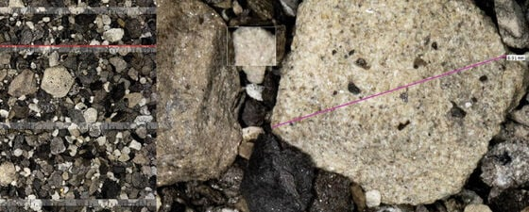
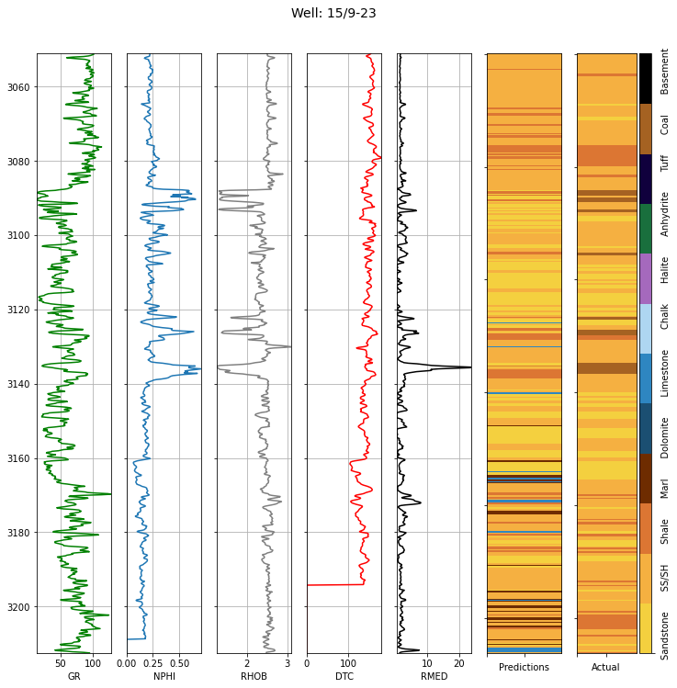

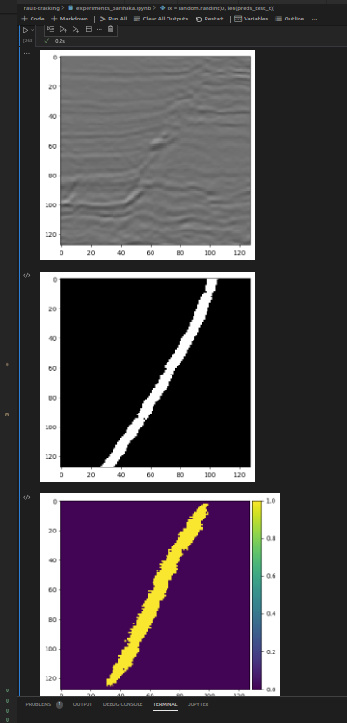
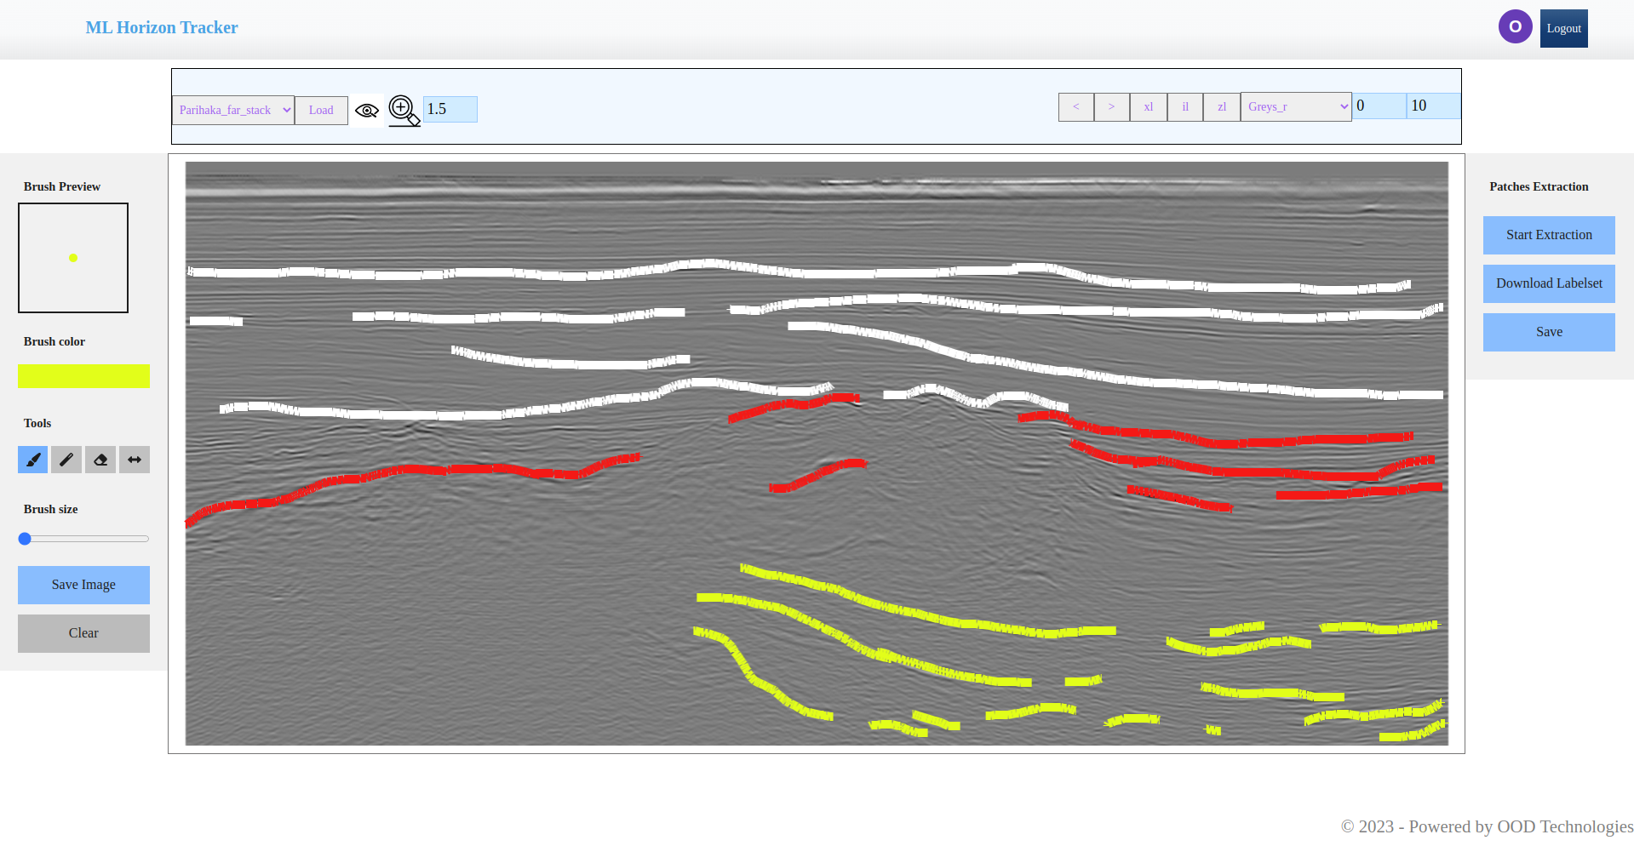
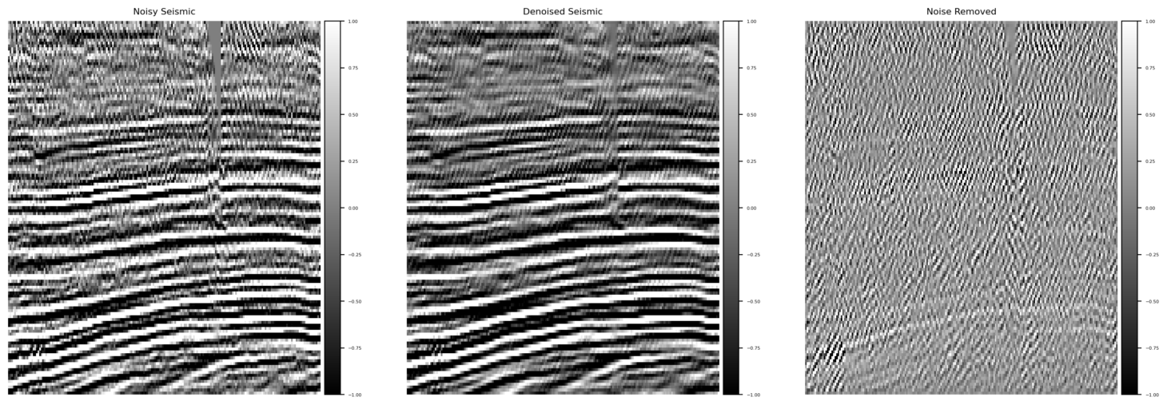
Applications, projects,...
Seismic horizon picking
Seismic denoising
Fault picking
Petrophysical interpretation
Well log interpretation
Sedimentology
Palynology

Slide 6
TEA BREAK

Slide 7
The Data Science End-to-End workflow
ETL (Extract, Transform, Load)
Data Cleaning
Exploratory Data Analysis
Data Preparation
Predictive Analysis
Optimize model
Problem
Need more data?
Model Evaluation
Happy model
Model/Solution Deployment
Worth noting: Efficiency and automation is key behind the entire workflow and its processes.

Slide 8













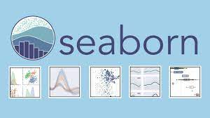


An Aggregation of Tools

Slide 9
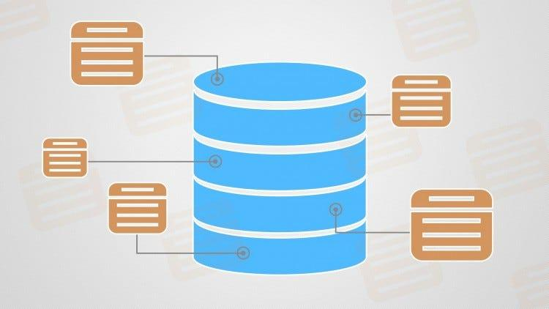
The Nature of Extract, Transform, Load (ETL)
Structured Data
Suitable Format
Unstructured Data
Tabular data; csvs, excel files, easier to work with, less storage required
✅
Reports, pdfs, image formats; jpegs, pngs, tiffs, difficult to work with, big data
Arrays, Dataframes, Rows and Columns, other standard formats

Slide 10
Notebook Demonstrations

Slide 11
DEPLOYMENT

Slide 12
Q&A

